Slide 1
Advanticsys
Weekly update – 05/05/2023
Discussion on treatment of missing data

Slide 2
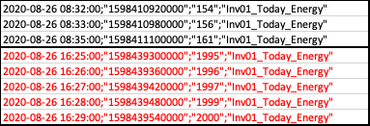
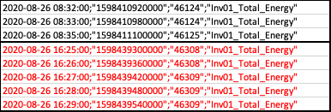
Data Error Found
Data is not constantly recorded
Example – Inv01 Energy data – 26/08/2020
Recording after 08:32:00 is 16:25:00 in both today_energy and total energy files (missing 8:34:00 as well)
Time is missing, however, energy reading seems correct

Slide 3
Issue
With missing time, we cannot know energy generation for each minute or 15 minutes in the period

Slide 4
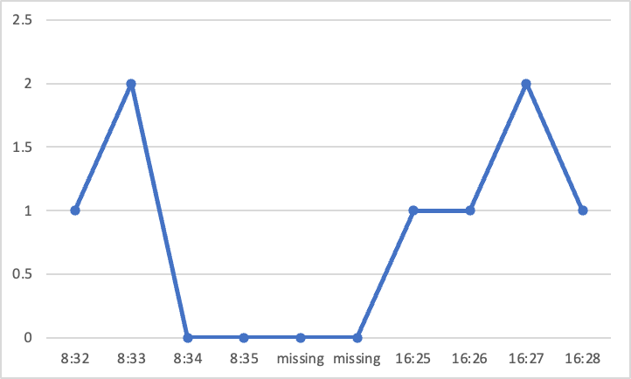
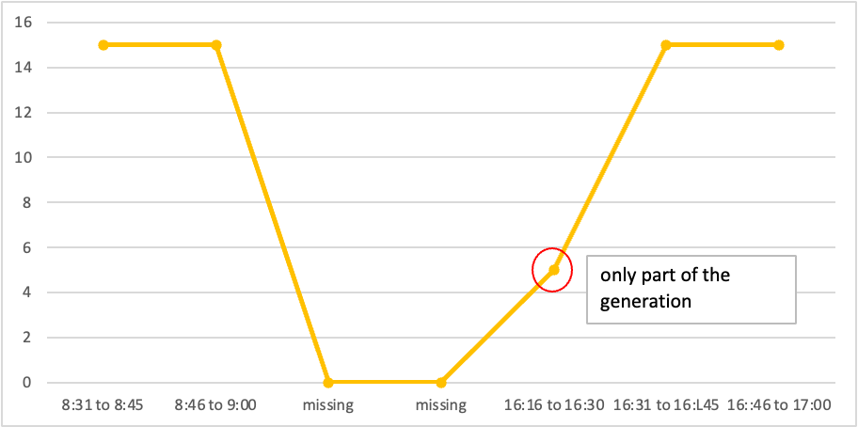
Proposal
Report whatever we have in data file as missing data can be an abnormal which need to be investigated
Summary by minute
Summary for each 15 mins

